Slide 2
My Learnings
Single and Multi-Camera Calibration: Learned how to calibrate cameras.
Feature Detection and Tracking: Understood how to detect and track features.
Reprojection Error: Learned what reprojection error is.
MINS Architecture: Understood the structure of MINS.
MSCKF Algorithm: basics of MSCKF for camera-IMU combination sensors.
Online Calibration with MINS: Learned to calibrate sensors in real-time.

Slide 3
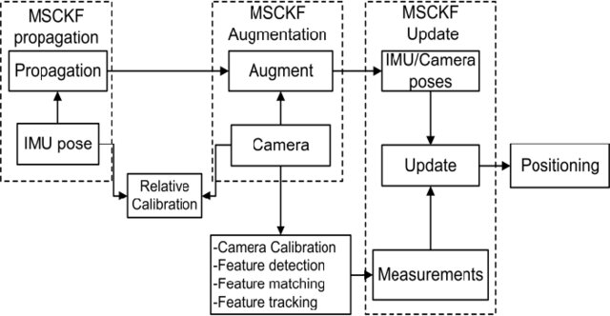
MSCKF architecture for camera IMU system
Uses IMU data to estimate the system's state over time.
Adds new camera measurements to improve accuracy.
Updates the state with visual features seen by the camera.
Adjusts estimates based on these features.

Slide 4


KPI
NEES is used as a KPI cause of its accuracy and reliability of state estimation in filtering algorithms.
Measures consistency by comparing estimation error to predicted uncertainty. Estimation error: ​ ; Error covariance matrix:
NEES is computed as:
Expected NEES should match the state vector's dimension (e.g., NEES ≈ 3 for 3D).
Example from UD warehouse dataset

